Slide 1
Hacking on Azure
Daniel Larsen
@DanielLarsenNZ
https://github.com/DanielLarsenNZ/Hacking-on-Azure

Slide 2
This talk
“Hacking”
Spotify Web API
Azure Websites + Node.js
Azure WebJobs + C#

Slide 3
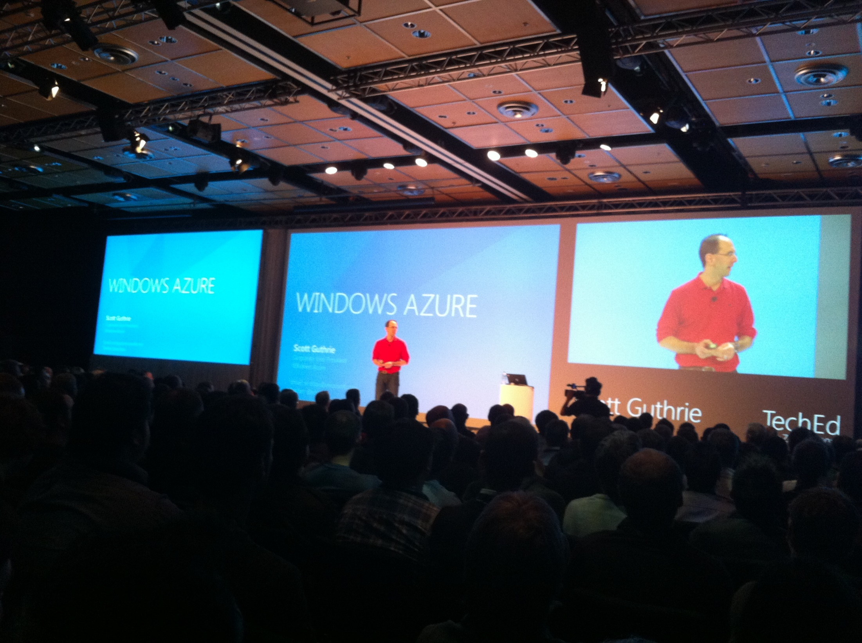

Slide 4
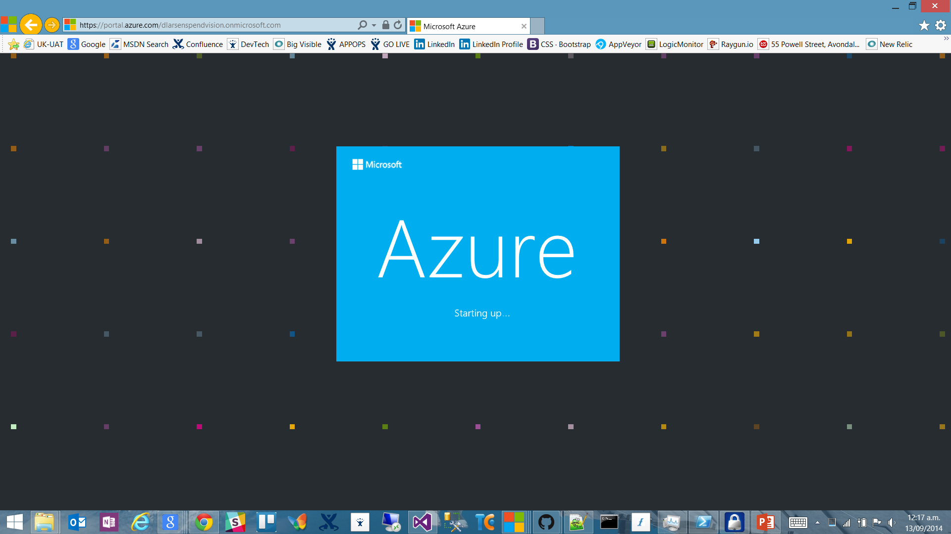

Slide 5
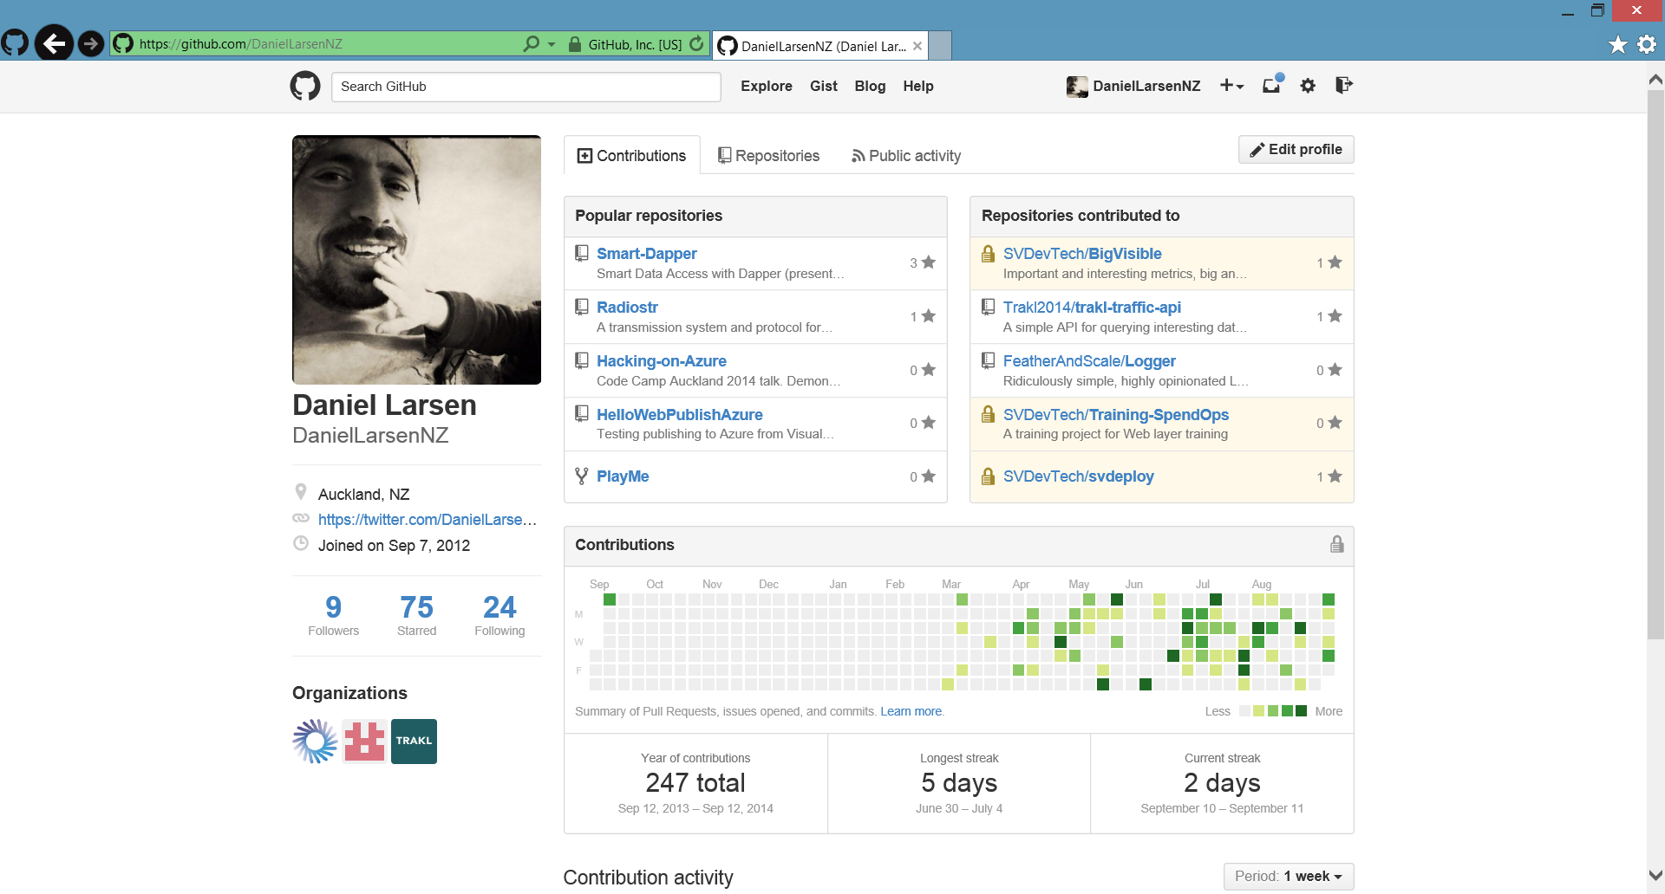

Slide 6
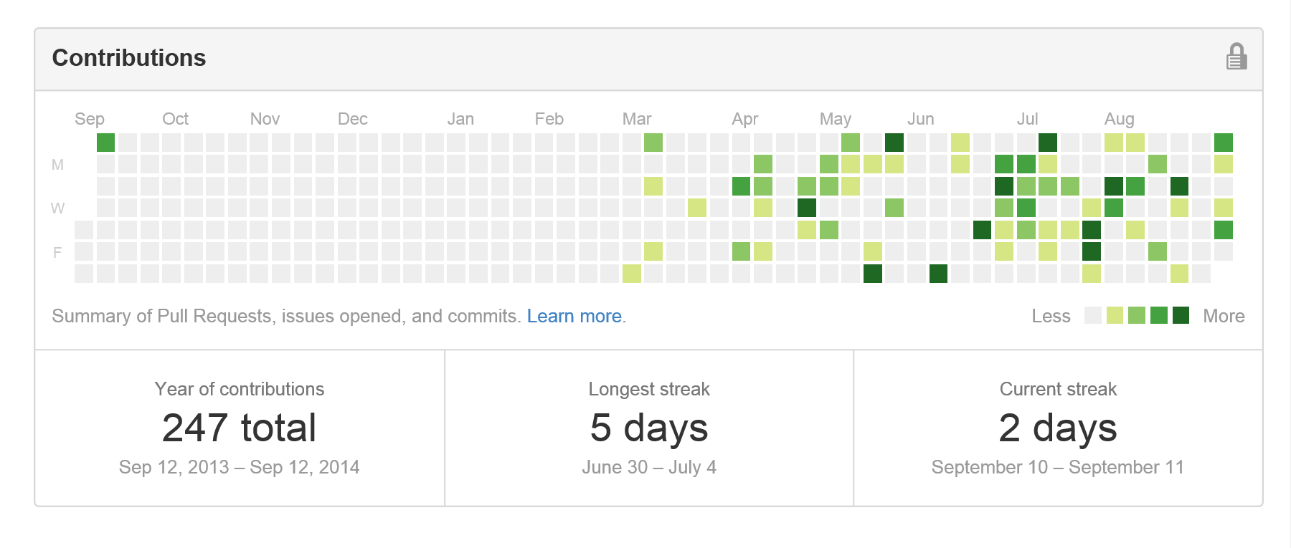
Contribution addiction

Slide 7
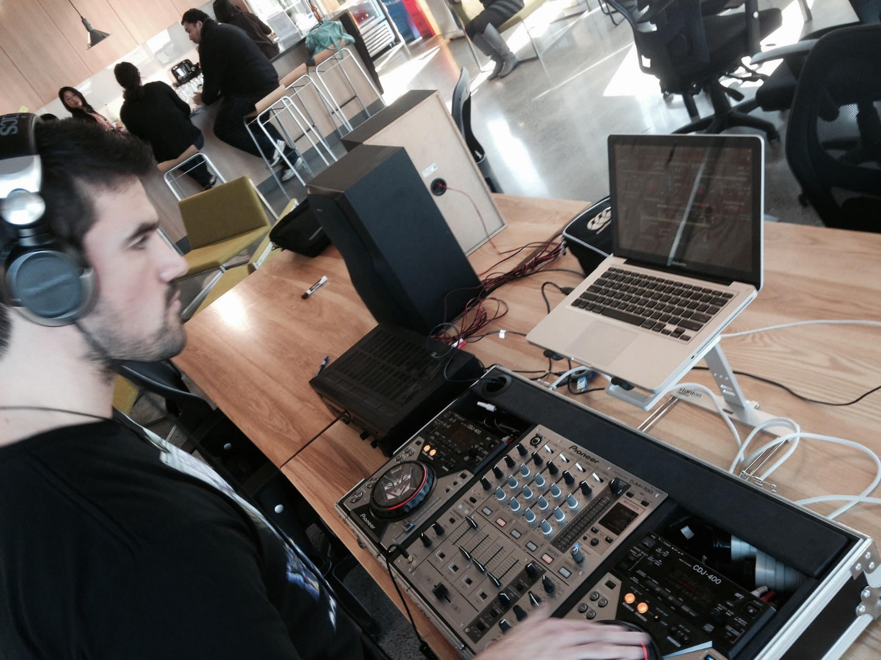

Slide 8
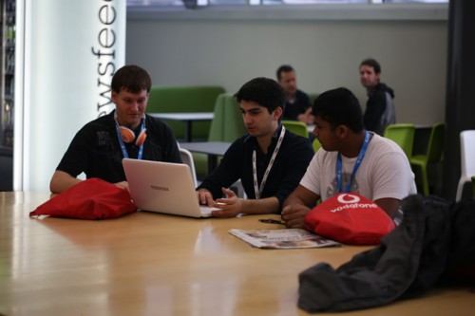
http://hackakl.org.nz/

Slide 9

http://en.memory-alpha.org/wiki/Phoenix

Slide 10

By NASA [Public domain], via Wikimedia Commons http://commons.wikimedia.org/wiki/File%3AApollo_11_Earth.jpg

Slide 11
Hacking
(This is not a Security talk)

Slide 12
Hacking is exploration
“The act of engaging in programming in a spirit of playfulness and exploration.
http://en.wikipedia.org/wiki/Hacker_(programmer_subculture)

Slide 13
Hacker enjoys exploring
“A person who enjoys exploring the details of programmable systems and stretching their capabilities.
http://en.wikipedia.org/wiki/Hacker_(programmer_subculture)

Slide 14
What is possible?
“Hacking entails some form of excellence, for example exploring the limits of what is possible, thereby doing something exciting and meaningful.
http://en.wikipedia.org/wiki/Hacker_(programmer_subculture)

Slide 15


Slide 16
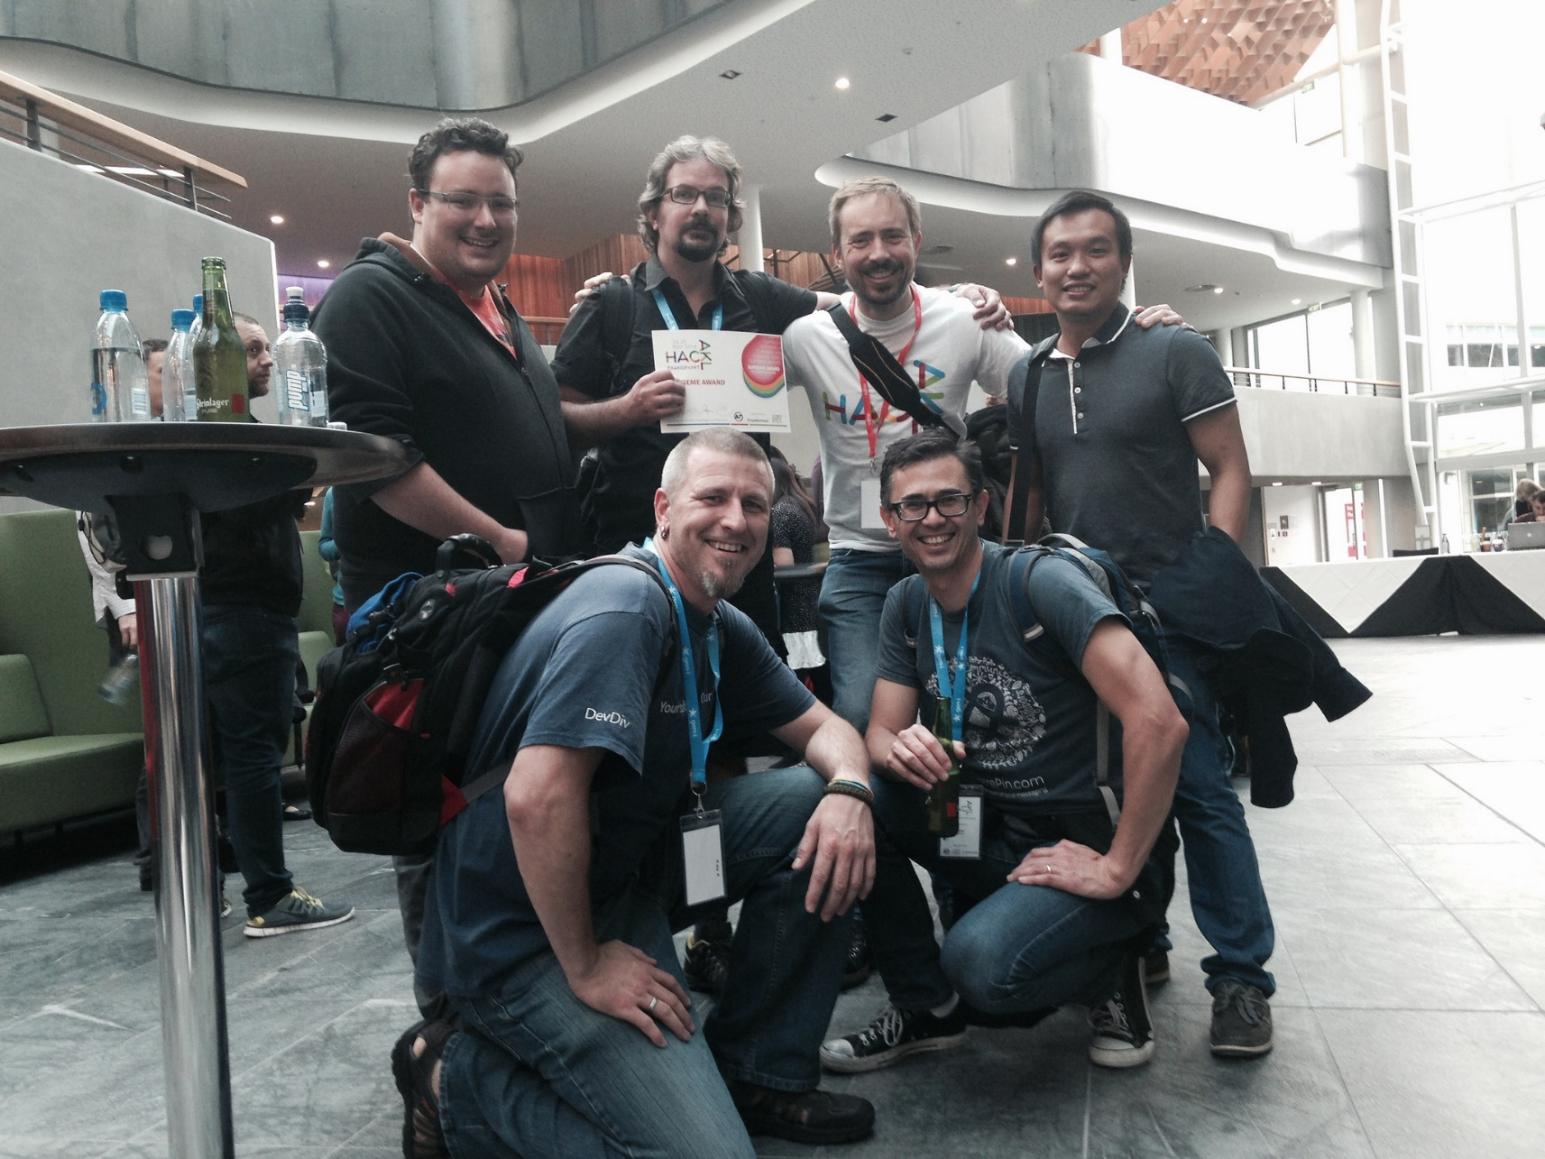

Slide 17
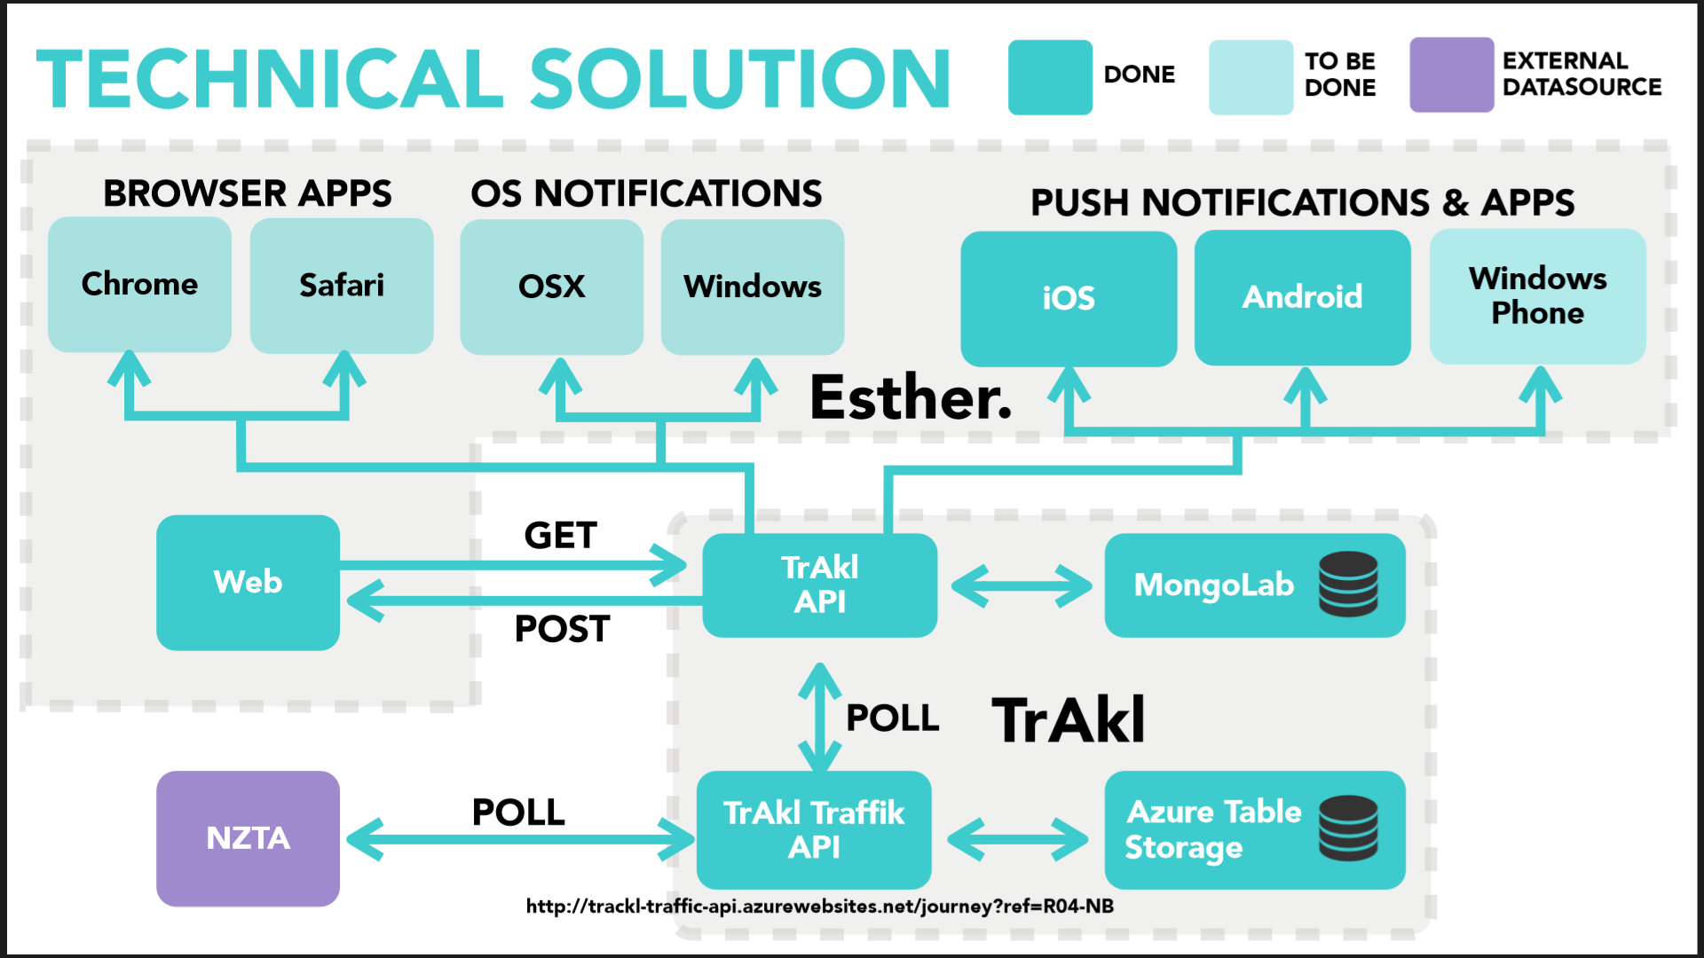

Slide 18
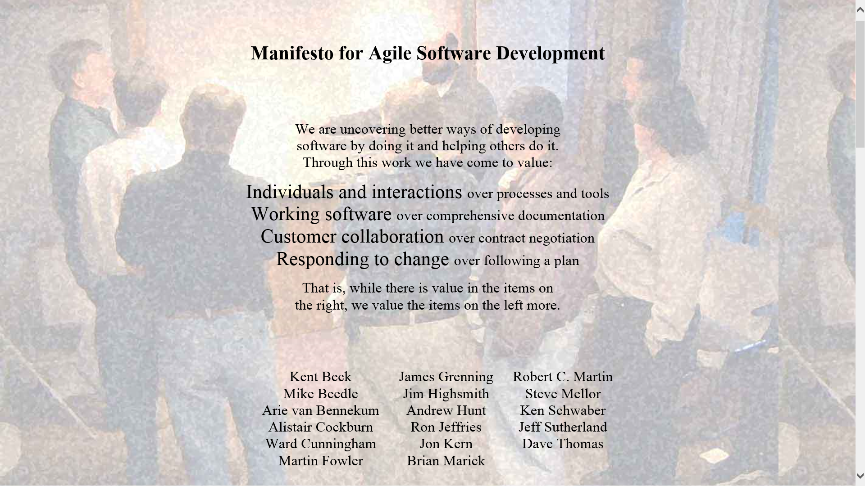

Slide 19
Demo
Node.js + NTVS + Azure Websites

Slide 20
Spotify Web API
https://developer.spotify.com

Slide 21
Demos
http://lab.possan.se/thirtify
http://static.echonest.com/enspex/
http://www.morecowbell.dj/
http://music.xbox.com/Developer
http://new.musichackday.org/

Slide 22
Hacking on Azure Websites + Node.js
And the Spotify Web API and Queue Storage

Slide 23
Feature map
Create a Jukebox
Import Spotify Playlists
Play

Slide 24
http://hackingon.azurewebsites.net/

Slide 25
Architecture phase 1
Browser client (Angular.js)
Azure Website
(Node.js)
Spotify Web API
Queue Storage

Slide 26
Da codez

Slide 27
Azure WebJobs + C#

Slide 28
Architecture phase 2
Browser client (Angular.js)
Azure Website
(Node.js)
Spotify Web API
Queue Storage
Table Storage
Azure WebJob
(C#)

Slide 29
Codez

Slide 30
Recap
“Hacking”
Spotify Web API
Azure Websites + Node.js
Azure WebJobs + C#

Slide 31
What I didn’t talk about
New Relic
Newman
GitHub deploy
Kudu
Edge.js
CoreCLR, OWIN, Density
Azure costs
Visual Studio Monaco
Lean

Slide 33
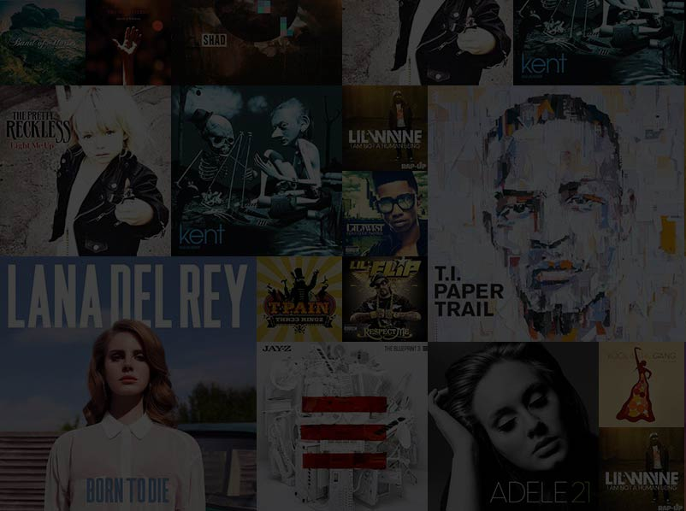

Slide 34
http://en.memory-alpha.org/wiki/Phoenix

Slide 35
By NASA [Public domain], via Wikimedia Commons http://commons.wikimedia.org/wiki/File%3AApollo_11_Earth.jpg

Slide 36
Chur!
Daniel Larsen
@DanielLarsenNZ
https://github.com/DanielLarsenNZ/Hacking-on-Azure

Slide 37
